Slide 1



Mega Analysis Querying Pipeline
Ali Alim-marvasti
Aug 2019

Slide 2
Mega Analysis: Search Strategy A Alim-Marvasti, G Ramognoli
PRISMA compliant
PubMed and filters, 1,171 papers (1,130 English), Jan 2019
All abstracts screened independently by two

Slide 3
Mega Analysis: Inclusion Criteria
Article and patient level (ground truth) inclusion criteria
Human studies
Abstract available in English
Focal Epilepsy
Topic focused on lateralising and/or localising value of epileptic seizure semiology
Full paper available in English, French, Spanish, Italian, German
Adults and Children (no age limit)
Spontaneous and/or stimulated seizures (cortical/electrical stimulation)

Slide 4
Mega Analysis: Patient level Inclusion Ground Truths & Priors
Lateralisation and Localisation
Ground Truths (patient-level inclusion)
Concordance (Neurophysiology, Imaging)
sEEG/CES
ILAE1/2 (Engel Ia/Ib) post-resection
Selection Priors / Study Type
Unselected patients
(Spontaneous Semiology)
Selected by prior lobe
(Epilepsy Topology/Anatomical)
Electrical Stimulation (ES)

Slide 5
Mega Analysis: Patient Exclusion Criteria
Generalised status epilepticus or primary generalised epilepsy
Non-epileptic (dissociative or pseudo-seizures)
Kappa <0.4 for semiology inter-observer agreements (where provided)
Broad localisation terms which do not determine lobe (e.g. “extra-temporal”)
Broad semiology terms which are uninformative (e.g. “focal seizure”, “complex partial”)
Outcomes worse than ILAE Class I or 2 or Engel Class Ia or Ib in post-operative patients
If patients underwent surgery, they must have had ILAE1,2 (Engel Ia/Ib) outcomes.
Patients with hemispherectomies (or entire hemispheric lesions irrespective of excellent post-operative outcomes) were entered for lateralisation but not localisation value.

Slide 6
Mega Analysis: Data Entry
Patient level (not seizure level)
Lateralisation/Localisation per Semiology per patient
Ground truth label and selection bias label entered
Numbers of patients entered
Numbers localising to each brain region entered
If more than one region, all regions entered
Hierarchical brain region data entry per semiology (hippocampus > mesial temporal > temporal lobe)

Slide 7
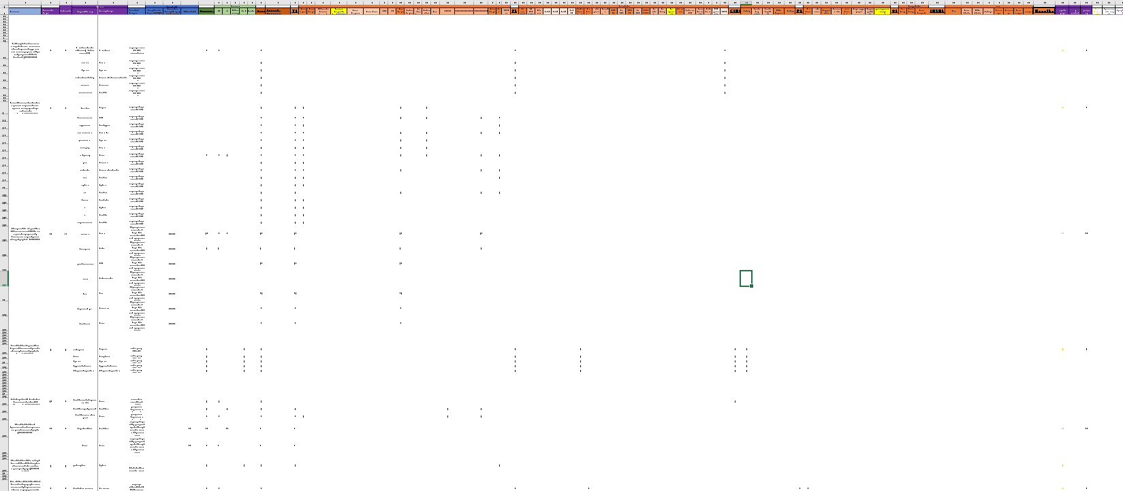

Slide 8
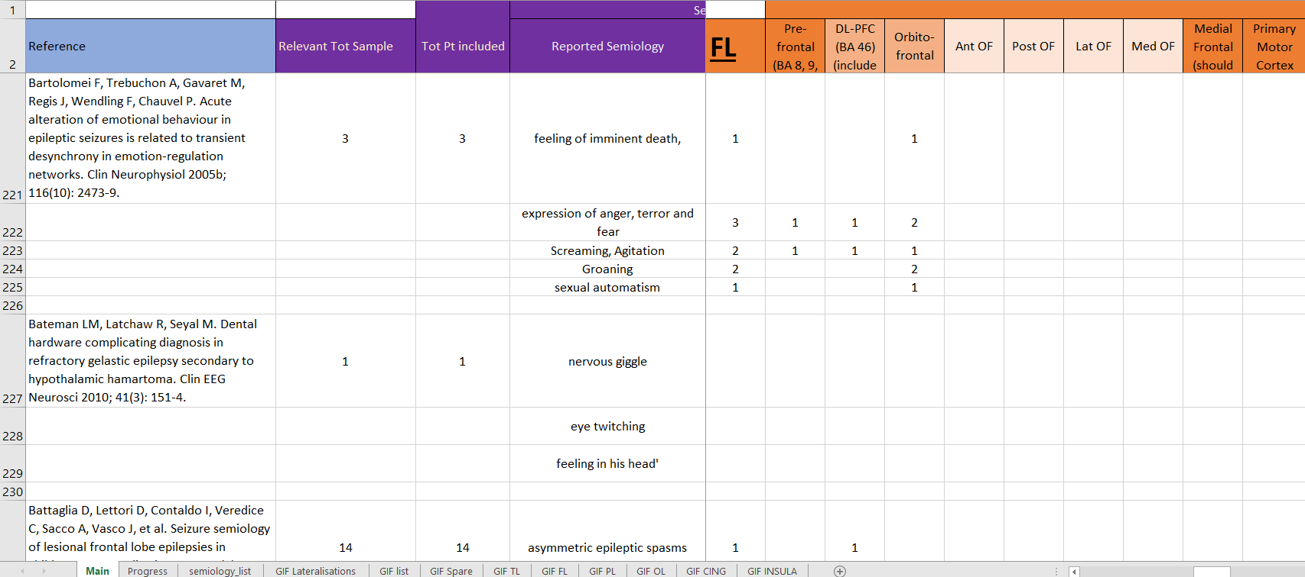

Slide 9
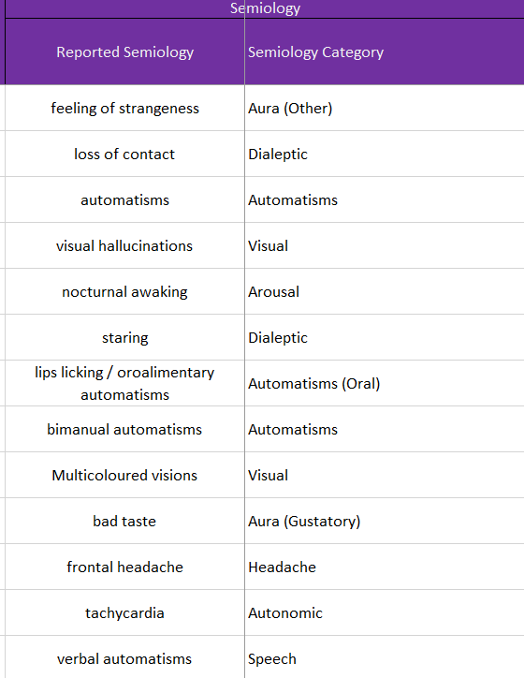
3 level ontology replacement
Query a specific semiology → Lat/Loc
How we mapped clinician query keyword(s) to semantic concept:
Data collection “Semiology Category”
Semiology Dictionary
(nested yaml taxonomy using regular expressions)
3. Clinician level: opportunity to filter results

Slide 10
Clinician’s Keyword Query Pipeline: Pandas, Scipy
MEGA_ANALYSIS
Preprocessing
Exploratory Data Visualisations (ground truth and selection priors)
QUERY_SEMIOLOGY
Regex searches
QUERY_INTERSECTION_TERMS (AND keywords)
melt_then_pivot
_query
Post-processing
pivot_result
_to_
pixel_intensities
EpiNav compatible:
QT filters infrequent localisations
Plots curve-fittings
pivot_result
_to_
one_map
Maps to Gif parcellations for EpiNav Visualisation
Dictionary taxonomy
OR keywords
Clinician’s inspections/filters
QuantileTransform
Calibrate
Scaling
Linear
Chi2
Flexible Exclusion Criteria
Notes:
Output of Mega Analysis is Venn diagrams, text output and preprocessed DataFrame: df
Output of QS is a table of relevant query results: inspect_result
Output of MTPQ is a single row of relevant results: pivot_result
Output of PRTPI is a single row of relevant results, with pixel intensities as values: pivot_result_intensities
Output of PRTOM is a table of Gif parcellations and their relevant pixel intensities: all_gifs

Slide 11
Clinician’s Keyword Query Pipeline: Lateralisation
MEGA_ANALYSIS
QUERY_SEMIOLOGY
melt_then_pivot_query
pivot_result_to_pixel_intensities
pivot_result_to_one_map
QUERY_LATERALISATION
Notes:
The reason it must first run then run again is not all localisations have lateralisations and vice versa.

Slide 12
